Slide 1

Eli Lilly & Co (LLY)
Time Series -
Stock Price Prediction
Esther Chung, Sherman Yu, Eumin Zoh

Slide 2
Table of Contents
01
02
03
04
05
06
About the company
Case context
Data preprocessing
Model selection
Model evaluation
Results and findings

Slide 3
01
Company Background

Slide 4

LLY (Eli Lilly And Co.)
Market leader in diabetes treatment: manufactures and sells Insulin
Strong presence in other pharmaceutical researches, eg. Oncology and Alzheimer’s disease
Founded in 1876
Ranked #119 in the 2021 Fortune 500 list

Slide 5
02
Case context

Slide 6
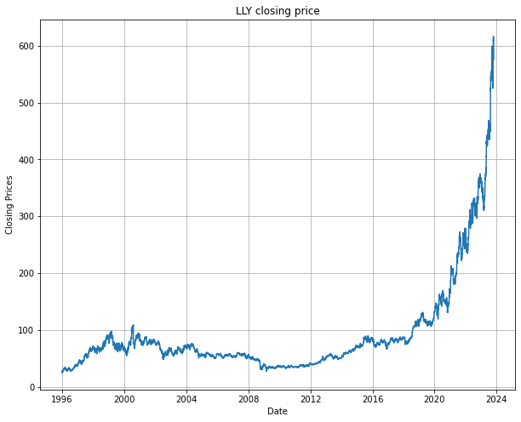
Case context
Forecasting Eli Lilly's Stock Price
Why Eli Lilly?
Recent rally in stock rise sparks interest in its prediction
Extract actionable insights for data-driven investment strategies and risk management
Data source:
Tradingview.com
Sampling period: 1996 - 2023
Research objectives:
Compare predictive capabilities of Linear Regression, LSTM, and ARIMA.
Evaluate model performance using MSE, MAE, and RMSE.

Slide 7
03
Data Preprocessing

Slide 8
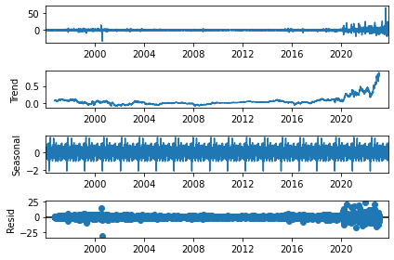
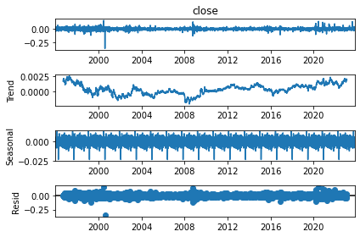
Data Preprocessing
Augmented Dickey-Fuller (ADF) Test is used to test for the stationarity of the data
Addressed non-stationarity using differencing.
Applied log transformation for variance stabilization.
Decomposed data to identify trend, seasonality, and residuals.

Slide 9
04
Model Selection

Slide 10
Model Comparison Matrix
Model | Type of model | Rationale & Strengths | Complexity
Linear Regression | Supervised learning regression model | Captures linear relationships. Suitable for straightforward trends. Transparent and interpretable | Simple & Efficient
LSTM | Deep learning model (RNN variant) | Recognizes complex, non-linear patterns. Captures long-term dependencies in stock prices | Complex
ARIMA | Time series model | Handles seasonality and cyclic patterns. Focuses on long-term trends and cyclic movements | Moderate

Slide 11
05
Model
Evaluation

Slide 12
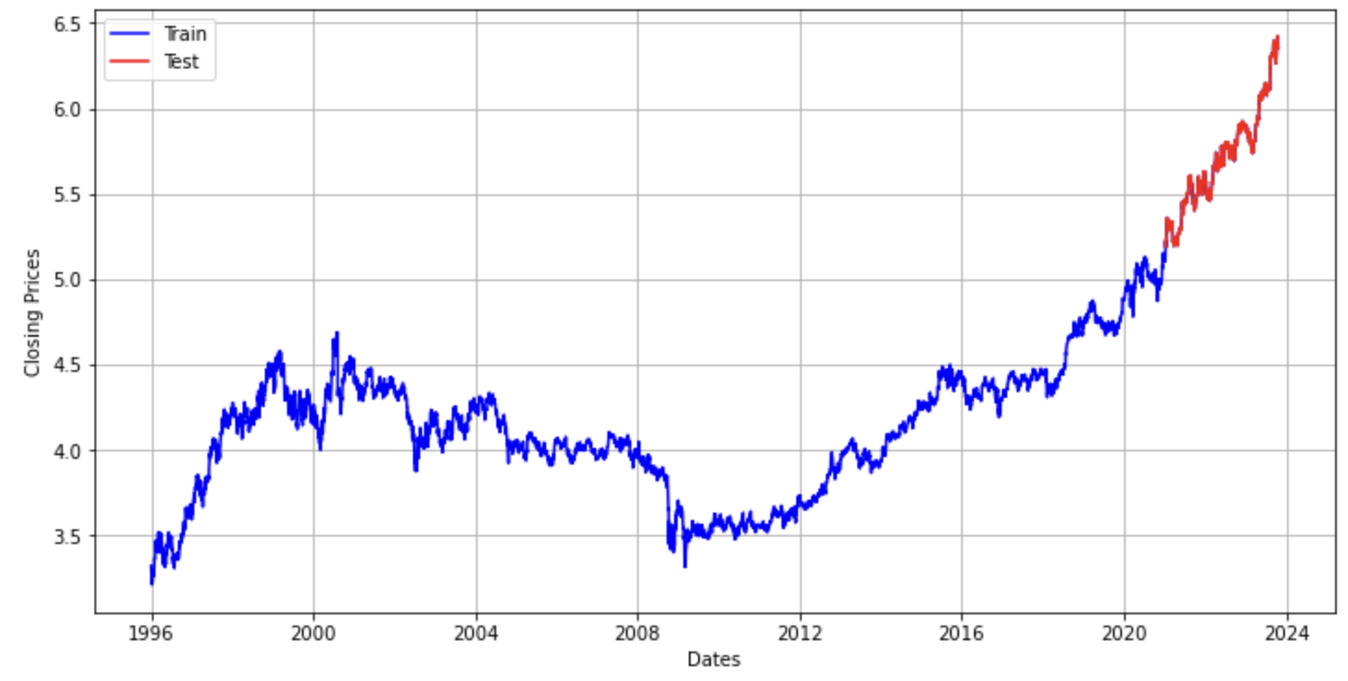
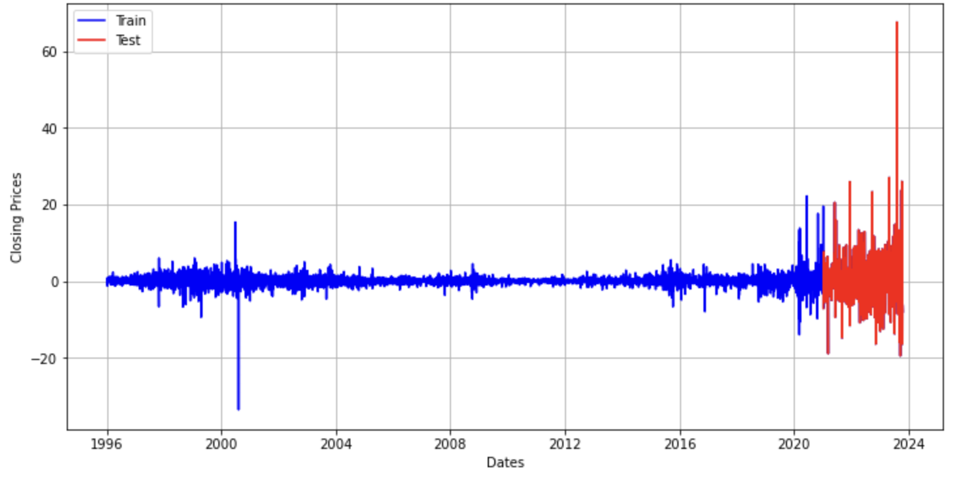
Model Evaluation
Data split: 80% training, 20% testing
Evaluation Metrics: MSE, MAE, RMSE, R-squared
Criteria for Model Evaluation:
Balance between simplicity and complexity.
Ability to capture both short-term fluctuations and long-term trends.
Emphasis on predictive accuracy for stock price movements.
Validation and out-of-sample testing

Slide 13
06
Results and findings

Slide 14
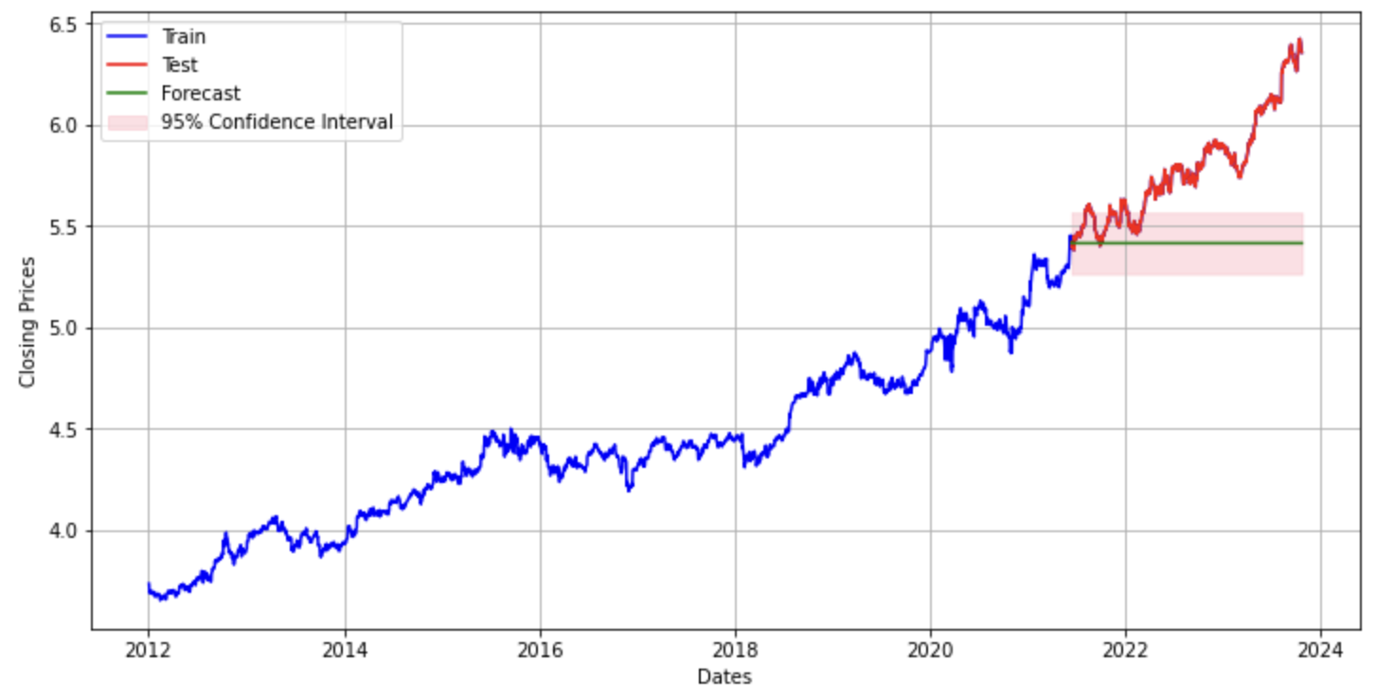
Discussion of model performance
ARIMA
Evaluations:
MSE: 1.0934132388369118
MAE: 0.9065660647087602
RMSE: 1.0456640181420185
MAPE: 0.16447930798010452

Slide 15
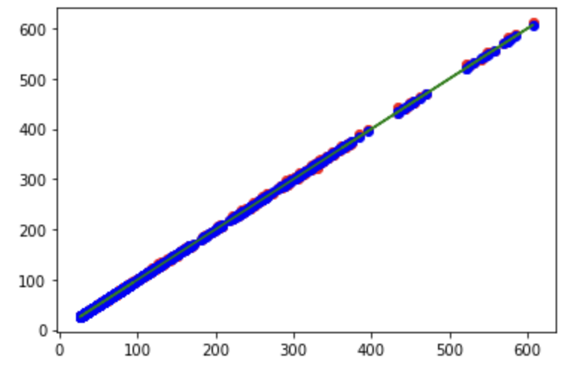
Discussion of model performance
Linear Regression
Evaluations:
MSE: 0.764
MAE: 0.459
RMSE: 0.874
R2 Score: 1.0

Slide 16
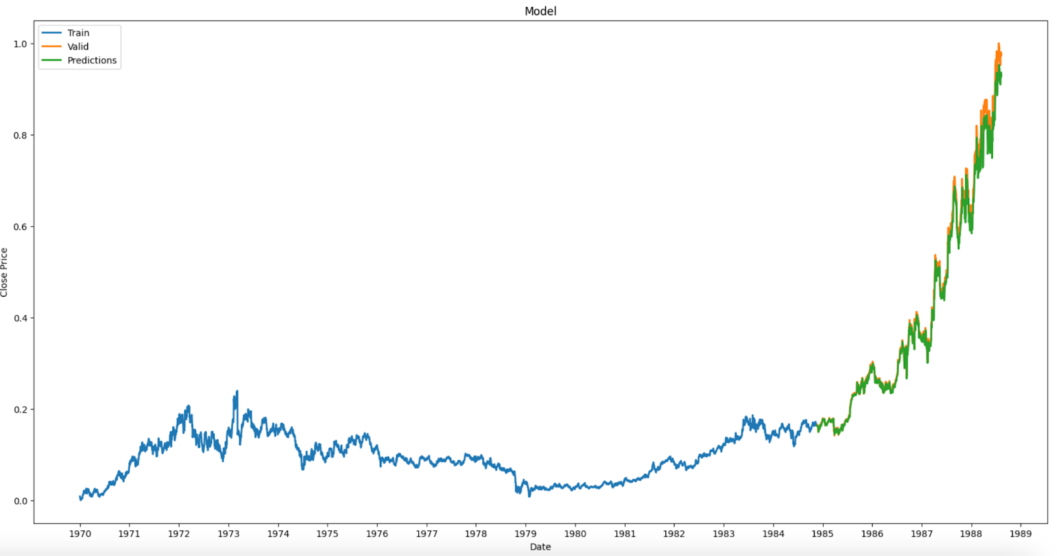
Discussion of model performance
LSTM

Slide 17
07
Conclusion

Slide 18

Thank you!

